Slide 1


DATA ANALYTICS INTERNSHIP PROGRAM -2024
IBM SkillsBuild for Adult Learners - Data Analytics
PROJECT NAME : "From Emission to Elimination: Analyzing the Journey to Net Zero"
UNIQUE ID : IBM2617
TEAM NAME : TEAM HAMCY
COLLEGE NAME : MAHARISHI DAYANAND UNIVERSITY
FINAL PROJECT PRESENTATION

Slide 2






TEAM MEMBERS :
TEAM HAMCY
DATA - INFO - INSIGHTS
Aaditya Dalal
Mohit Sharma
Chitra Pahuja
Yashwant Jakhar
Harshita

Slide 3

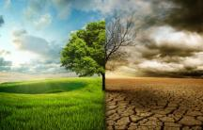
INTRODUCTION & OVERVIEW:
Climate change poses a critical threat to the global environment, economies, and communities. In response, the UN Sustainable Development Goals (SDGs) and the Paris Agreement have set ambitious targets for reducing greenhouse gas emissions and achieving net zero emissions.
This project aims to develop a data analytics prediction model to analyze and forecast emission data from major cities worldwide. By leveraging advanced data analytics tools and methodologies, the project seeks to propose actionable solutions to support the Net Zero Emission goals of the Paris Agreement and Decarbonization which involves the reduction of carbon dioxide emissions through various means, such as transitioning to renewable energy sources, improving energy efficiency, and adopting sustainable practices across industries, aligning with two Sustainable Development Goals (SDG 13): Climate Action and (SDG 11): Sustainable Cities and Communities

Slide 4


PROBLEM STATEMENT:
Metropolises and downtown areas are the bustling hearts of our world, yet they are also hotspots for greenhouse gas emissions, driven by relentless industrial activities, heavy transportation, and voracious energy consumption. These emissions accelerate climate change, triggering severe environmental and health crises. Despite global initiatives like the Paris Agreement, the path to net-zero emissions is riddled with obstacles, mainly due to imprecise data and ineffective policies.
This project aims to transform this narrative. By diving deep into emission data, we aim to uncover hidden patterns, accurately predict future emission trajectories, and devise smart, targeted interventions to drastically cut emissions in major cities. Through cutting-edge analytics and bold strategies, we aspire to craft a blueprint for a sustainable and vibrant urban future

Slide 5
DATA COLLECTION:
SOURCES :
Original Source:
https://ourworldindata.org/co2-and-greenhouse-gas-emissions
Github Link:
https://github.com/owid/co2-data/blob/master/README.md
Data Description:
https://github.com/owid/co2-data/blob/master/owid-co2-codebook.csv
Data:
https://github.com/owid/co2-data/blob/master/owid-co2-data.csv
DESCRIPTION :
Our complete Emissions dataset is a collection of key metrics maintained by ‘Our World in Data’. The CSV files follow a format of 1 row per location and year. The indicators represent all of our main data related to CO2 emissions, other greenhouse gases,energy mix,as well as other indicators of potential interest.

Slide 6
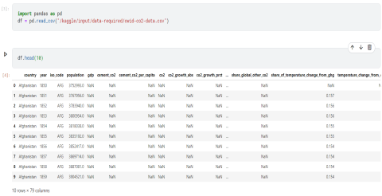
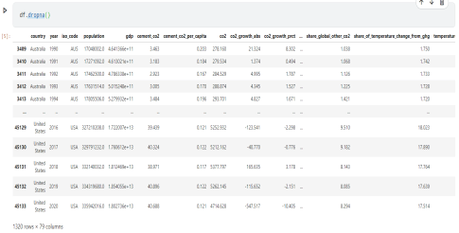
DATA PREPROCESSING:
Removal of Null Values
Removing them from the dataset is usually best if the null values are due to human error or data collection issues. Impute the null values. If the null values are due to technical problems or if they are important to the analysis, you may want to impute them.

Slide 7
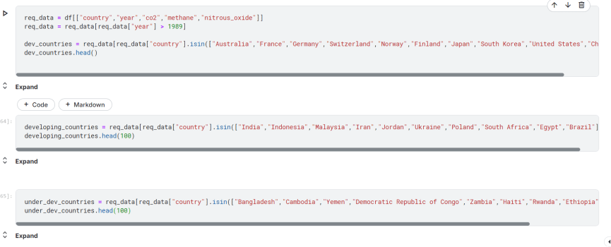
TARGETED SELECTION OF COLUMNS ACCORDING TO PROJECT FOCUS
Segregation of the major emission contributing attributes namely Carbon-Dioxide, Methane and Nitrous Oxide with a categorization of different types of countries yearly from 1990 to 2023.

Slide 8
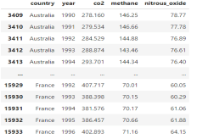
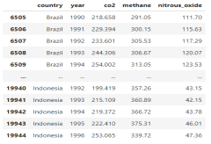
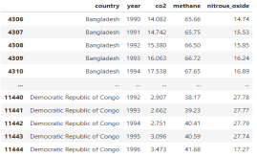
Initial Data Insights After Cleaning:
Classification of the countries into 3 groups namely, “Developed”,“Developing”, and “Underdeveloped” will help us to foster a general understanding between Carbon Emissions and Development Metrics.
Identification of seemingly useful attributes that could draw essential insights in the near future. The major contributors of the carbon emission were CO2 and Methane. Moreover Nitrous Oxide was also one of the major pollutant.
From our cleaned data we were somehow only able able to get a rough estimate about the increasing/decreasing emissions of different categories countries thats why some visualization was must for getting the exact insights.

Slide 9
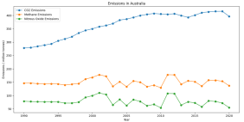
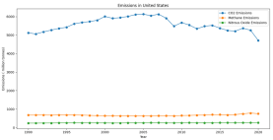
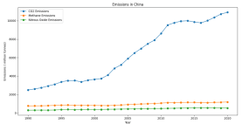
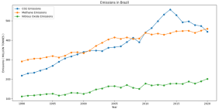
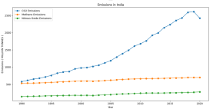
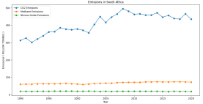
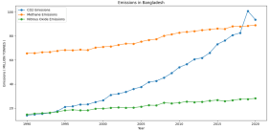
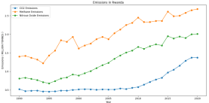
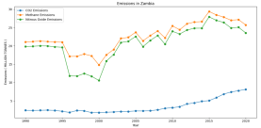
DATA VISUALIZATION:
Line charts depicting CO2, CH4, and N20 emissions of categorized countries from the year 1990 to 2020.
Developed Countries
Developing Countries
Under- Developed Countries

Slide 10
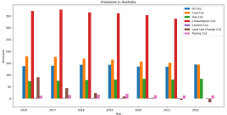
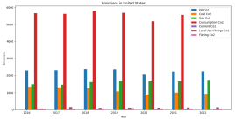
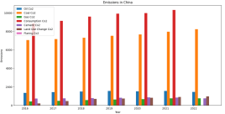
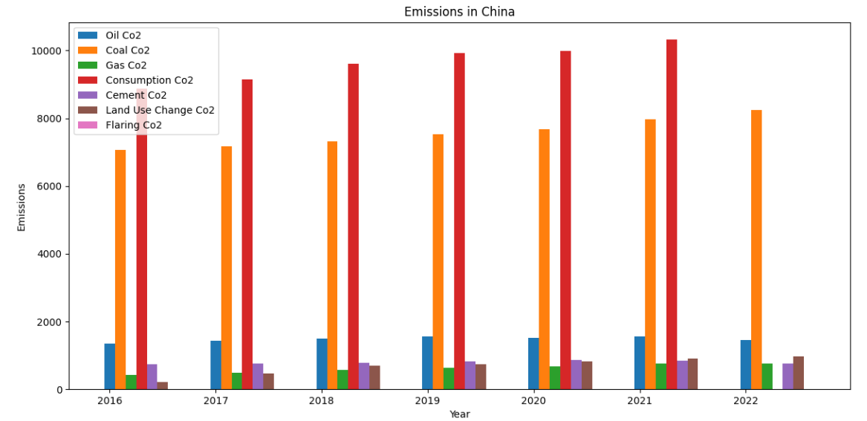
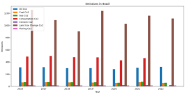
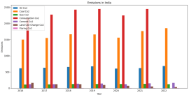
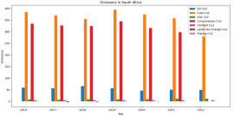
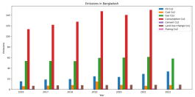
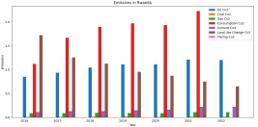
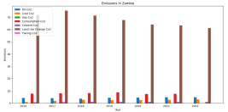
Bar charts showing various sources of CO2 emissions of the categorized countries from the year 2016 to 2022*
Developed Countries
Developing Countries
Under- Developed Countries

Slide 11
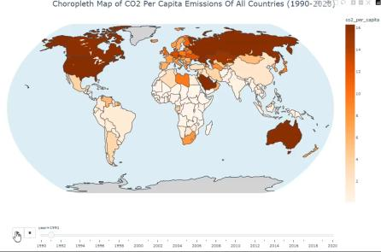
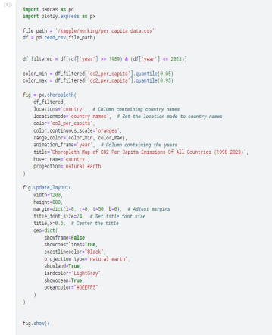
CHOROPLETH - MAP VISUALIZATIONS:
Interactive visualization of overall CO2 emissions all around the world from the year 1990 to 2022.
The shade of the color represents the extent of emissions.

Slide 12
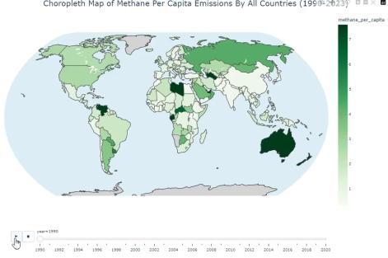
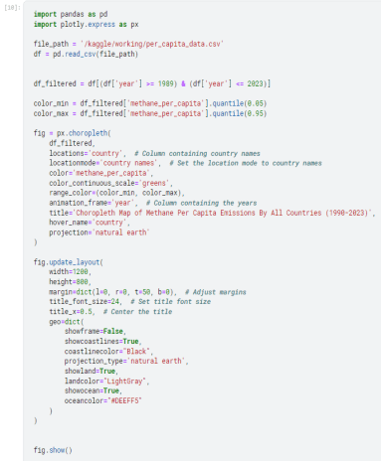
CHOROPLETH - MAP VISUALIZATIONS:
Interactive visualization of overall ‘METHANE’ emissions all around the world from the year 1990 to 2022.
The shade of the color represents the extent of emissions.

Slide 13
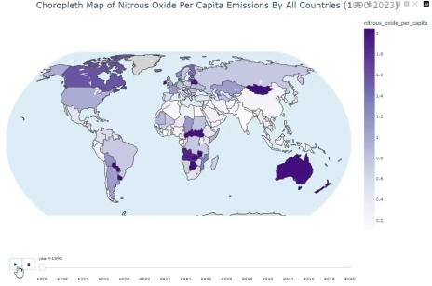
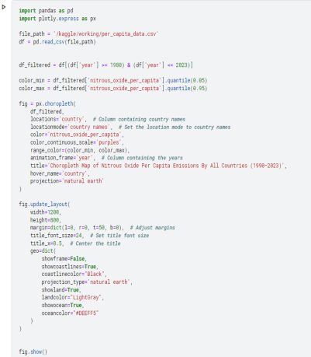
CHOROPLETH - MAP VISUALIZATIONS:
Interactive visualization of overall ‘Nitrous Oxide’ emissions all around the world from the year 1990 to 2022.
The shade of the color represents the extent of emissions.

Slide 14
Insights derived from Visualizations:
The line chart visualizations illustrate the emission trends of CO2, CH4, and N2O. From these plots, it is evident that in developed countries, CO2 emissions vastly exceed those of CH4 and N2O by approximately 600%. In contrast, this disparity is significantly reduced to a mere 110-170% in the charts for developing countries, and CO2 and N2O emissions are either comparable to or exceed those of CO2 in case of underdeveloped countries.
From bar chart visualizations of extensive CO2 sources in various countries, it is evident that developed countries primarily emit CO2 through consumption-based emissions, which are associated with the goods and services consumed domestically. In developing countries, the major contributors to CO2 emissions are fossil fuels, particularly oil and coal. However, consumption-based CO2 emissions are also rising rapidly in these regions. In underdeveloped countries, the main sources of CO2 emissions are land-use changes, such as the transformation of forest land for commercial purposes, alongside fossil fuel-based emissions.
The visualizations clearly indicate that the traditional industrialization process results in a significant increase in net greenhouse gas emissions. This trend is evident from the choropleth map, which shows that as countries undergo industrialization over time, their emissions correspondingly rise. The correlation between industrial growth and heightened emissions underscores the environmental impact of conventional industrial practices.
Another notable observation is that countries with larger areas of forest cover are experiencing rapid deforestation. This is evident from the increasing CO2 emissions resulting from land-use changes, indicating a significant loss of forested areas. The rise in these emissions highlights the environmental impact of deforestation in these regions.

Slide 15
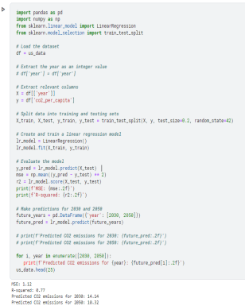
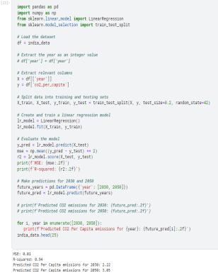
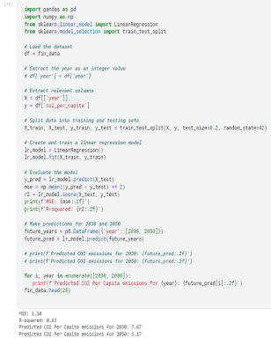
LINEAR REGRESSION MODEL: ( for predicting emissions in UN target years )
PREDICTION MODEL FOR THE USA
PREDICTION MODEL FOR INDIA
PREDICTION MODEL FOR FINLAND

Slide 16
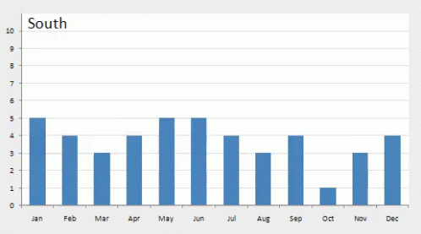
HYPOTHESIS:
By leveraging a linear regression machine learning algorithm to analyze historical data and trends from the past two decades, our prediction model can accurately estimate CO2 emissions per capita for the years 2030 and 2050.
Independent Variable: Year (1990-2020)
Dependent Variable: CO2 emissions per capita
Supporting Data
Historical Data: Data from 2000 to 2020, including variables such as economic indicators, energy consumption, industrial output, population growth, and technological advancements.
Model Evaluation:
Mean Squared Error (MSE): Indicates the average squared difference between predicted and actual values.
R-squared (R²): Indicates the proportion of variance in the dependent variable that is predictable from the independent variable(s).
If the hypothesis holds true, our model's predictions will align closely with actual CO2 emissions per capita for the years 2030 and 2050, demonstrating the efficacy of linear regression in forecasting long-term environmental trends.

Slide 17
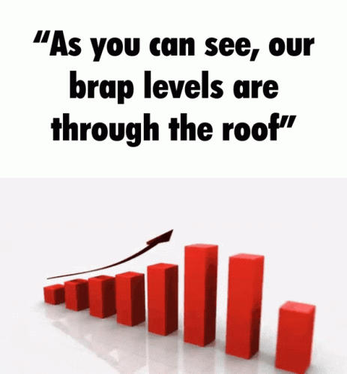
Outcomes of Prediction Model:
Under the Paris Agreement, participating nations are committed to reducing their carbon emissions by 45% by the year 2030, using 2010 emission levels as a baseline. Additionally, these countries aim to achieve a fully decarbonized status, targeting net-zero emissions by mid-century.
Our prediction model harnesses the power of a linear regression machine learning algorithm to forecast CO2 emissions per capita for the years 2030 and 2050. By meticulously analyzing data and identifying trends from the past two decades, our model delivers precise and insightful estimates to aid in environmental planning and policy-making.
Mathematical Formula for estimating the percentage increase/decrease of CO2 emissions per capita
( CO2 per capita in 2010 ) - ( Predicted CO2 per capita in 2030 ) x 100
=
( CO2 per capita in 2010 )
Using the above formula and predicted values by the regression model we can calculate the probability of meeting the UN set target for certain selected countries.
CO2 per capita emissions in the USA would decrease by 22.5% in the year 2030 as per the predictions made by the regression model.
CO2 per capita emissions in India would increase by 64.4% in the year 2030 as per the predictions made by the regression model.
CO2 per capita emissions in Finland would decrease by 35.7% in the year 2030 as per the predictions made by the regression model.
Applying the model for other countries also gives similar trends for nations with identical economic and geographic conditions.

Slide 18


Outcomes and Probable Solutions:
Outcomes:
Emission Trends: The prediction model indicates significant variation in CO2 emission trends across different countries. Developed countries show a potential decrease in emissions, while developing and underdeveloped countries exhibit either stable or increasing trends.
Policy Effectiveness: Current policies are not sufficient to meet the UN's 2030 and 2050 targets. The projected data reveals that most countries will fall short of the required reductions if current practices continue.
Key Contributors: Industrial activities, energy consumption, and land-use changes remain the primary contributors to greenhouse gas emissions.
Probable Solutions:
Implement carbon pricing mechanisms, such as carbon taxes or cap-and-trade systems, to incentivize reduction in CO2 emissions..
Cultivate international cooperation to share best practices and technologies for reducing emissions from fossil fuels.
Sustainable Urban Planning: Develop green cities with efficient public transportation, green spaces, and low-emission buildings.
Encourage sustainable urban development with efficient public transportation and green infrastructure.
Support reforestation and afforestation projects to restore forest cover and enhance carbon sinks.
Invest in green technologies and sustainable industrial practices to decouple industrial growth from emissions.
Invest in carbon capture, storage, and utilization technologies.

Slide 19

CONCLUSION:
In conclusion, addressing the urgent challenge of greenhouse gas emissions in urban areas requires a sophisticated and data-driven approach. Our project’s development of a Multifaceted Data Analytics Prediction Model represents a critical step towards this goal. By leveraging comprehensive emission data and advanced analytics, we aim to uncover patterns, forecast future trends, and propose targeted interventions that will drive significant reductions in emissions. Aligning our strategies with the net-zero targets of the Paris Agreement and the Sustainable Development Goals, this model seeks to provide actionable insights that will empower cities to cut their emissions drastically. Ultimately, our project aspires to lay the groundwork for a sustainable and vibrant urban future, ensuring that metropolises around the world can thrive while contributing to a healthier planet.
Countries such as the USA, Finland, Norway, and Australia have made notable strides in decarbonization, achieving significant progress in reducing their carbon footprints. In contrast, developing nations like India, Brazil, and Indonesia grapple with a complex dilemma: they face the dual challenge of pursuing rapid economic development while mitigating negative environmental impacts. The tension between advancing infrastructure, economic growth, and committing to climate conservation represents a significant global challenge. These nations must navigate the delicate balance of advancing development to improve living standards and achieving sustainability goals without impeding their progress. Striking this balance is crucial for ensuring that both development and environmental preservation can coexist, ultimately leading to a more equitable and sustainable future for all.

Slide 20





References and Tech-Stack:
TECHSTACK:
Python: For data cleaning, analysis, and visualization, using libraries such as Pandas, NumPy, and Matplotlib.
Jupyter Notebooks: For documenting the analysis process and visualizations.
Python Libraries for prediction modeling: ScikitLearn For developing predictive models and machine learning algorithms.
Plotly: For spatial analysis and creating geographic visualizations of emission data.
REFERENCES:
Our World In Data : https://ourworldindata.org/
UN SDGs : https://sdgs.un.org/
Pandas Documentation : https://pandas.pydata.org/docs/
Plotly Documentation : https://plotly.com/python/
ScikitLearn Documentation : https://scikit-learn.org/

Slide 21
THANK YOU !
Crafted with love by Team HAMCY

